Slide 1
Analyzing Airbnb Listings in Amsterdam
Done by:
Fatema Mohamed
Sara Waleed
Mohamed AlMurbati

Slide 2
Table of contents
01
02
03
04
INTRODUCTION
Framing the Problem
Findings of the Analysis
Conclusion and Recommendations

Slide 3
Introduction
Amsterdam is one of the most visited cities in Europe, known for its tourism, culture, and vibrant short-term rental market. Airbnb, a global platform for vacation rentals, plays a major role in the city’s accommodation sector. This case explores the performance of Airbnb listings in Amsterdam to support a potential investment decision. The analysis focuses on identifying the most popular neighbourhoods, the highest-rated property types, and estimating the revenue successful hosts typically earn.

Slide 4
FRAMING THE PROBLEM
Problem Statement
In Amsterdam’s Airbnb market, neighbourhoods like De Baarsjes – Oud-West host over 900 listings, while others have fewer than 50. Investors lack clear, data-driven insights on how listing counts, guest ratings, and average revenue per stay can vary across neighbourhoods and property types. This makes it difficult to identify the most profitable and popular investment opportunities
AIM
To identify the most suitable neighbourhood and property type for Airbnb investment in Amsterdam by analyzing listing popularity, guest reviews, and estimated revenue per stay.

Slide 5
objectives
Examine neighborhood and host listing counts to identify the neighborhood with the most listings.
Examine property type against review scores to discover which property type receives the most positive feedback.
Analyze review description and revenue to identify the average revenue of successful hosts.
1
2
Analyze price data per neighborhood and property types to pinpoint which neighborhood are the most popular and attractive one.
3
4
Analyze accommodation capacity and Popular Property Types to find the most common one.
5

Slide 6
Objectives
WH Questions
Which neighbourhood has the most Airbnb listings in Amsterdam?
What are the most common property types listed on Airbnb in Amsterdam?
What property type receives the highest guest ratings in Amsterdam?
What are the most common room types and accommodation capacities in Amsterdam’s Airbnb market?
Where are prices and revenues the most attractive?
How does revenue vary among successful Airbnb hosts across different property types?

Slide 7
Objectives
Hypothesis
Neighbourhoods with the most listings indicate popular and profitable areas.
Entire properties are the most common and highest-rated type.
Price and revenue vary by neighbourhood and property type, reflecting demand.
Entire properties generate more revenue than other types.

Slide 8
Findings of the analysis

Slide 9
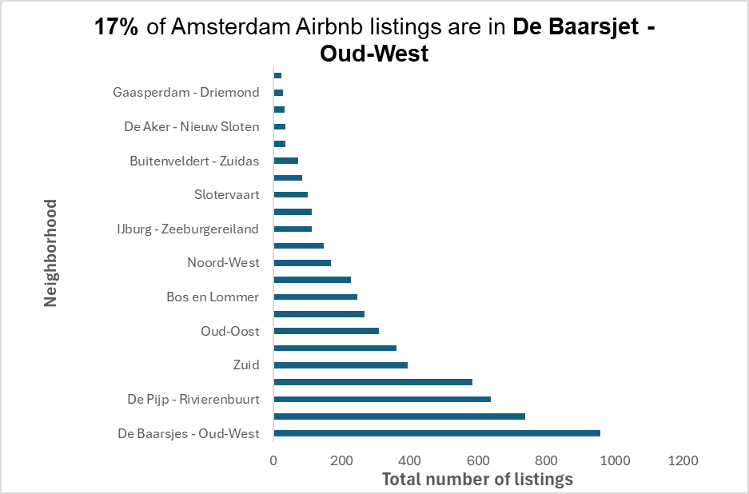
Most Popular Neighbourhoods by Number of Airbnb Listings in Amsterdam
The analysis shows that the neighbourhoods with the highest number of Airbnb listings are De Baarsjes - Oud-West, Centrum-West, and De Pijp – Rivierenbuurt
De Baarsjes has the highest number of listings, indicating strong Airbnb activity.

Slide 10
Top-Rated Airbnb Property Types in Amsterdam
This table shows the top-rated property types in Amsterdam based on guest reviews. While these listings are rare, they consistently earn exceptional ratings from guests. Their uniqueness and charm likely contribute to this positive feedback
Property Types in Amsterdam with Highest Guest ratings
Property_Types | Average of review_scores_rating | Count of id
Shepherdâ€™s hut | 5 | 1
Shared room in boat | 5 | 1
Hut | 5 | 1
Private room in cabin | 4.96 | 1
Tower | 4.95 | 1

Slide 11
Top-Rated Airbnb Property Types in Amsterdam
Entire rental units, condos, and homes are the most common property types.
These receive high average review scores (4.85–4.9).
Private rooms have slightly lower ratings (4.7–4.8).
Property Type | Average of rating
Entire condo | 4.88
Entire home | 4.88
Entire rental unit | 4.85
Private room in rental unit | 4.74

Slide 12
Average Price by Neighbourhood
Centrum-West has the highest price at $312, likely due to its central location.
De Baarsjes – Oud-West has the most listings, priced at $278.
De Pijp – Rivierenbuurt is also strong, with an average of $289.

Slide 13
Average Price by Property Type
Entire rental units have the lowest average price among the top property types, making them an attractive option for both guests and potential hosts.

Slide 14
Average Revenue by property type
$1082 the average revenue from Entire rental unit.
Entire rental unit considered the second highest revenue type.
Most listings investing in Entire rental unit.

Slide 15
Most Common Property Types by Neighbourhood
Entire rental units are the most common in almost all neighborhoods.
Entire condos are especially popular in Centrum-West and De Baarsjes – Oud-West.
Entire homes appear more in Centrum-West and De Pijp – Rivierenbuurt.
Overall, full-property listings dominate the market across top neighborhoods.

Slide 16
Room Types Across Neighbourhoods
Entire home/apartment is the most common room type in all key neighbourhoods.
Private rooms are also widely listed, especially in Centrum-Oost and Centrum-West.
Shared rooms and hotel rooms are very limited across all areas.

Slide 17
Accommodation Capacity by Popular Property Types
Most listings are for 2-person stays, especially in entire rental units and entire condos.
Listings that accommodate 4 guests are also common, especially in entire homes.
This shows that the market mainly serves small groups and couples.

Slide 18
Conclusion
De Baarsjes-Oud-West shows strong rental performance based on the data.
The area maintains consistent occupancy and competitive pricing.
Entire rental unit type was the most chosen due to low prices and consistent revenue.
overall recommendation
Focus investment on De Baarsjes-Oud-West due to its high potential.
Choose Entire rental units because they make more money and guests stay longer.
Focus your investment on 2-person listings.

Slide 19
Thanks!

